Slide 1
Natural Topographies: Data Formulations
Copyright August 17, 2022 by Themesis, Inc.
All rights reserved.
Contact: themesisinc1@gmail.com

Slide 2
Code Used and GitHub Repository
Results from Using the Program to Compute the Configuration Variables:
2D-CVM-def-pttrns_anlytc-FE-vary-e1-v1pt5_2021-04-08.py
Updated:
2D-CVM-def-pttrns_anlytc-FE-vary-e1-v1pt5_2022-03-14.py
Most recent – compute a set of divergences across a range of h-values for a given pattern (select from among the four patterns pre-encoded into the Python code):
2D-CVM-def-pttrns_anlytc-FE-var-Vayes_v1pt2_2022-03-30.py
Data Sets and Associated Code Patterns:
Nat. Top. #1: Pattern 1
Nat. Top. #2: Pattern 2
Nat. Top. #3, v. (a): Pattern 3
Nat. Top. #3, v. (b): Pattern 4
This PPT and the associated codes are uploaded to the following GitHub Repository:
ajmaren/2-D-CVM-w-Var-Bayes

Slide 3
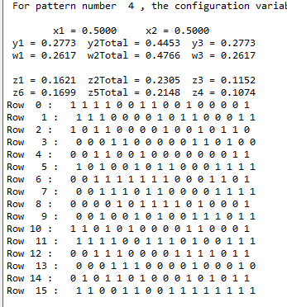
Natural Topography #3
Version (b)
Results from Using the Program to Compute the Configuration Variables:
2D-CVM-def-pttrns_anlytc-FE-vary-e1-v1pt5_2021-04-08.py
Used Pattern 4 for this trial (Nat. Top. 3b).
Select Configuration Variables:
z1: 0.1621
z3: 0.1152
y2: 0.445/2 = 0.223

Slide 4

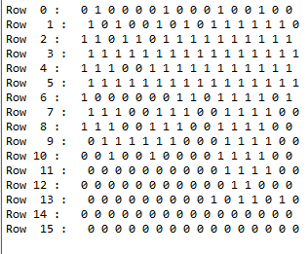
Row 15*
*wrap-around
Natural Topography #1: Highest Cohesion
Node Activations Entered into Program
Row 0
Row 1
Row 2
Row 3
Row 4
Row 5
Row 6
Row 7
Row 8
Row 9
Row 10
Row 11
Row 12
Row 13
Row 14
Row 15

Slide 5
Natural Topography #2
Version (a)
Natural Topography #2: Moderate Dispersion
Numbers of Black Nodes
Row 15*
*wrap-around
Row 0: 6 (4,2)
Numbers of Black Nodes
Summary:
Row 1: 4 (2,2)
Row 0
Row 2: 2 (0,2)
Row 1
Row 3: 10 (2,8)
Top Half: 44 (x, x)
Bottom Half: 84 (x, x)
Row 2
Row 4: 10 (2,8)
Row 3
Row 5: 2 (0,2)
Row 4
Row 6: 4 (2,2)
Row 5
Total: 128
Row 7: 6 (4,2)
Row 6
Row 8: 12 (6,6)
Row 7
Row 9: 8 (4,4)
Row 8
Row 10: 12 (8,4)
Row 9
Row 11: 10 (6,4)
Row 10
Row 12: 10 (6,4)
Row 11
Row 13: 12 (8,4)
Row 12
Row 13
Row 14: 8 (4,4)
Row 14
Row 15: 12 (6,6)
Row 15

Slide 6
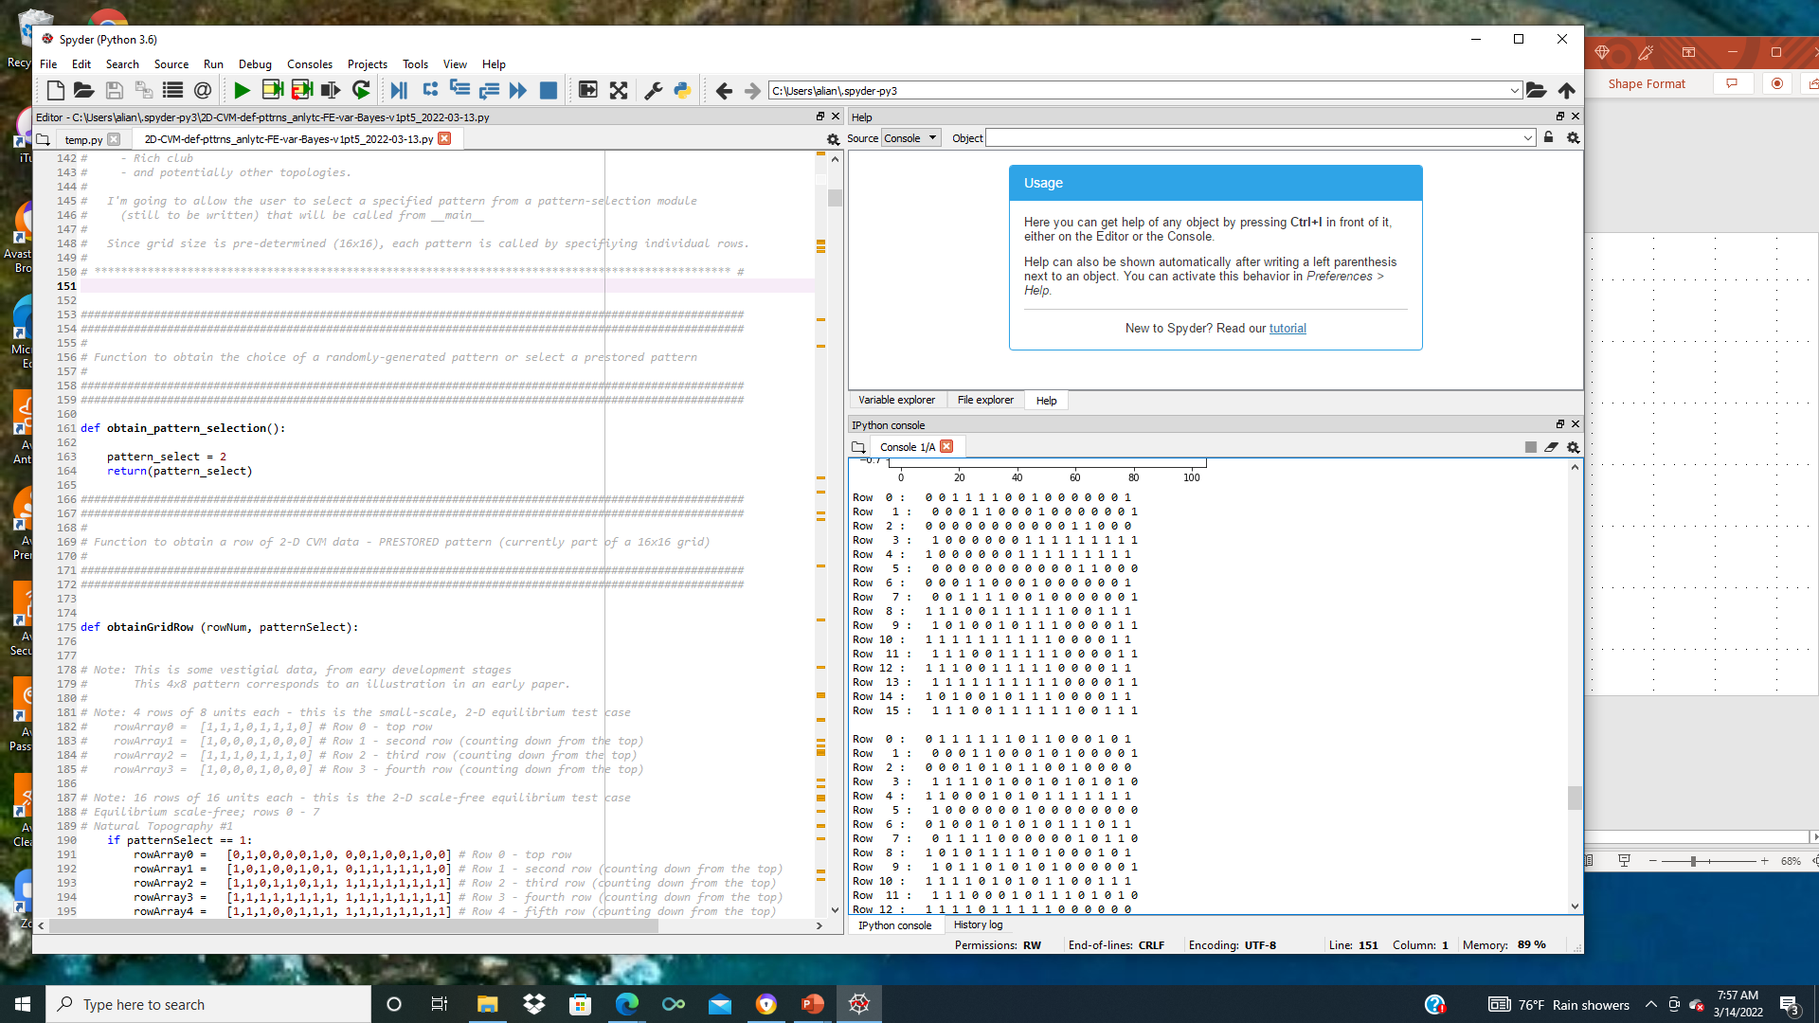
Natural Topography #2: Moderate Dispersion
Row 15*
*wrap-around
Row 0
Row 1
Row 2
Row 3
Row 4
Row 5
Row 6
Row 7
Row 8
Row 9
Row 10
Row 11
Row 12
Row 13
Row 14
Row 15

Slide 7
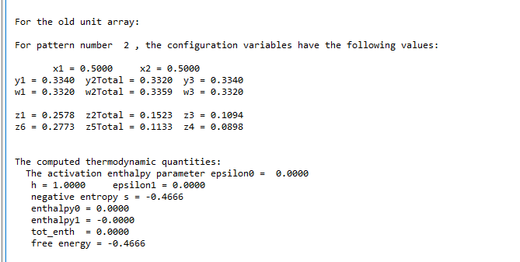

Slide 8
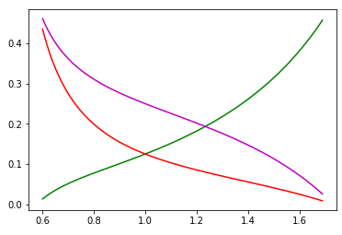
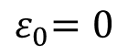
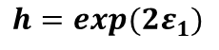
We Can Obtain Analytic Results for Certain Cases
Natural Topography #2
Analytic Values for Configuration Variables y₂, z₁, and z₃
Case where activation enthalpy : x₁ = x₂ = 0.5
$${ ε}_{0}=0$$
B
A
A
y₂
Z₃:
Z₁:
y₂:
B
B
A
A
A
A
A
z₁
y₂
z₁
z₃
Configuration variable
h = 1 (ε₁ = 0)
Nat. Top. #2:
z₃
y₂ = 0.166
z₁ = 0.258
z₃ = 0.109
h: interaction enthalpy parameter;
$${ h=exp(2ε}_{1})$$

Slide 9
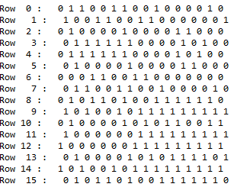
NOTE: Originally had this noted as V (a).
Corrected 2022/03/14
Natural Topography #3
Version (b)
Row 15*
*wrap-around
Natural Topography #3: High Dispersion
Row 0
Row 1
Row 2
Row 3
Row 4
Row 5
Row 6
Row 7
Row 8
Row 9
Row 10
Row 11
Row 12
Row 13
Row 14
Row 15
NOTE: Correcting first node (0,0) position: Changed from black to white, to meet computer code (see RHS) version w/ verified x=0.5. Corrected 2022/03/14

Slide 10
Natural Topography #3
Version (b)
Using four of the 8x8 grid overlays to create a 16x16 grid
Row 15*
*wrap-around
Natural Topography #3: High Dispersion
Numbers of Black Nodes
Row 0
Row 0: 8 (6,2)
Row 1
Row 1: 8 (4,4)
Row 2
Row 2: 7 (3,4)
Numbers of Black Nodes
Summary:
Row 3
Row 3: 5 (2,3)
Row 4
Row 4: 5 (3,2)
Top Half: 61 (33, 28)
Bottom Half: 67 (30, 37)
Row 5
Row 5: 9 (4,5)
Row 6
Row 6: 10 (6,4)
Row 7
Row 7: 9 (5,4)
Row 8
Row 8: 7 (3,4)
Row 9
Row 9: 8 (3,5)
Row 10
Row 10: 7 (4,3)
Row 11
Row 11: 11 (6,5)
Row 12
Row 12: 9 (3,6)
Row 13
Row 13: 5 (3,2)
Row 14
Row 14: 8 (4,4)
Row 15
Row 15: 12 (4,8)

Slide 11
Natural Topography #3
Version (b)
Results from Using the Program to Compute the Configuration Variables:
2D-CVM-def-pttrns_anlytc-FE-vary-e1-v1pt5_2021-04-08.py
Used Pattern 4 for this trial.
Select Configuration Variables:
z1: 0.1621
z3: 0.1152
y2: 0.445/2 = 0.223

Slide 12
Configuration Variable Values and Corresponding h-values
Tpgrphy | Pattern | z₁ | z₃ | y₂ | h-value (low) | h-value (high)
1 | 1 | 0.3145 | 0.0645 | 0.125 | 1.45 | 1.55
2 | 2 | 0.2578 | 0.1094 | 0.166 | 1.05 | 1.35
3(a) | 3 | 0.1816 | 0.1152 | 0.211 | 1.05 | 1.19
3(b) | 4 | 0.1621 | 0.1152 | 0.223 | 1.05 | 1.15

Slide 13
We Can Obtain Analytic Results for Certain Cases
Natural Topography #1
Analytic Values for Configuration Variables y₂, z₁, and z₃
Case where activation enthalpy : x₁ = x₂ = 0.5
$${ ε}_{0}=0$$
B
A
A
y₂
Z₃:
Z₁:
y₂:
B
B
A
A
A
A
A
z₁
y₂
z₁
z₃
Configuration variable
h = 1 (ε₁ = 0)
Nat. Top. #1:
z₃
y₂ = 0.250/2
= 0.125
z₁ = 0.315
z₃ = 0.065
h: interaction enthalpy parameter;
$${ h=exp(2ε}_{1})$$

Slide 14
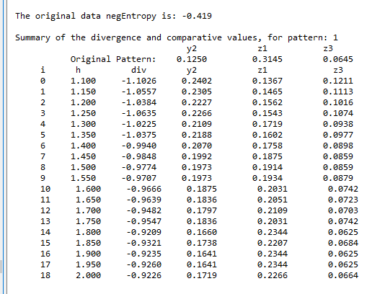
REVISED CODE: Pattern #1, Rich-Club-Like; 2022-03-30; Run #1

Slide 15

REVISED CODE: Pattern #1, Rich-Club-Like; 2022-03-30; Run #2

Slide 16

REVISED CODE: Pattern #1, Rich-Club-Like; 2022-03-30; Run #3

Slide 17

REVISED CODE: Pattern #1, Rich-Club-Like; 2022-03-30; Run #4

Slide 18

REVISED CODE: Pattern #1, Rich-Club-Like; 2022-03-30; Run #5

Slide 19

REVISED CODE: Pattern #1, Rich-Club-Like; 2022-03-30; Run #6

Slide 20
AVERAGE OF RESULTS: Pattern #1, Rich-Club-Like; 2022-03-30
Run Numb. | h | Diverg. | y₂ | z₁ | z₃
1 | 1.80 | -0.9209 | 0.1660 | 0.2344 | 0.0625
2 | 2.00 | -0.9140 | 0.1523 | 0.2520 | 0.0527
3 | 1.85 | -0.9286 | 0.1621 | 0.2402 | 0.0566
4 | 1.95 | -0.9124 | 0.1602 | 0.2441 | 0.0605
5 | 1.90 | -0.9329 | 0.1660 | 0.2285 | 0,0645
6 | 1.95 | -0.9138 | 0.1621 | 0. 2326 | 0,0645
AVG. | 1.91 |  | 0.1614 | 0.2386 | 0.0602

Slide 21
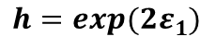
We Can Obtain Analytic Results for Certain Cases
Natural Topography #1
Analytic Values for Configuration Variables y₂, z₁, and z₃
Case where activation enthalpy : x₁ = x₂ = 0.5
$${ ε}_{0}=0$$
B
A
A
y₂
Z₃:
Z₁:
y₂:
B
B
A
A
A
A
A
z₁
y₂
z₁
z₃
Configuration variable
h = 1 (ε₁ = 0)
Orig.
Model
z₃
Nat. Top. #1:
Nat. Top. #1:
y₂ = 0.250/2
= 0.125
y₂ = 0.161
z₁ = 0.315
z₁ = 0.239
z₃ = 0.065
z₃ = 0.060
h: interaction enthalpy parameter;
$${ h=exp(2ε}_{1})$$

Slide 22
We Can Obtain Analytic Results for Certain Cases
Natural Topography #2
Analytic Values for Configuration Variables y₂, z₁, and z₃
Case where activation enthalpy : x₁ = x₂ = 0.5
$${ ε}_{0}=0$$
B
A
A
y₂
Z₃:
Z₁:
y₂:
B
B
A
A
A
A
A
z₁
y₂
z₁
z₃
Configuration variable
h = 1 (ε₁ = 0)
Nat. Top. #2:
z₃
y₂ = 0.166
z₁ = 0.258
z₃ = 0.109
h: interaction enthalpy parameter;
$${ h=exp(2ε}_{1})$$

Slide 23
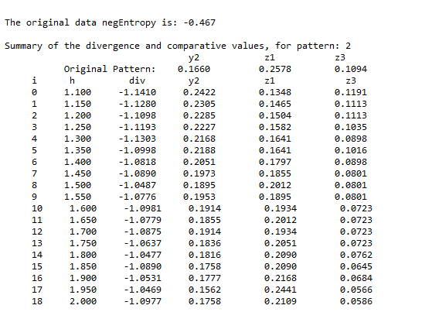
Revised Code: Pattern #2, Intermediate; 2022-04-04; Run #1

Slide 24
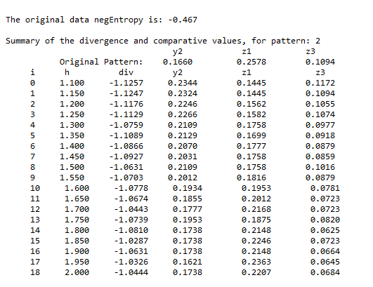
Revised Code: Pattern #2, Intermediate; 2022-04-04; Run #2

Slide 25
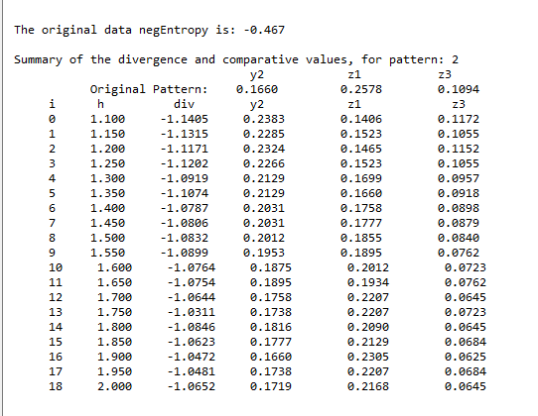
Revised Code: Pattern #2, Intermediate; 2022-04-04; Run #3

Slide 26
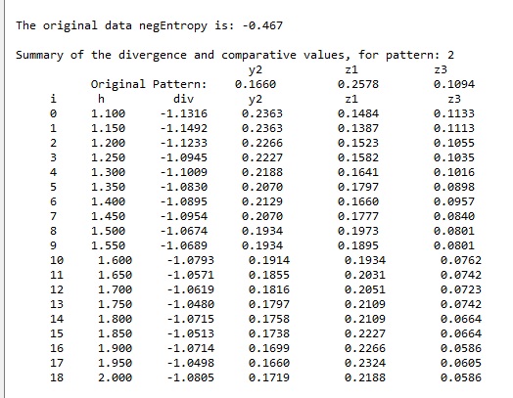
Revised Code: Pattern #2, Intermediate; 2022-04-04; Run #4

Slide 27

Revised Code: Pattern #2, Intermediate; 2022-04-04; Run #5

Slide 28

Revised Code: Pattern #2, Intermediate; 2022-04-04; Run #6

Slide 29

Revised Code: Pattern #2, Intermediate; 2022-04-04; Run #7

Slide 30

Revised Code: Pattern #2, Intermediate; 2022-04-04; Run #8

Slide 31

Revised Code: Pattern #2, Intermediate; 2022-04-04; Run #9

Slide 32

Revised Code: Pattern #2, Intermediate; 2022-04-04; Run #10

Slide 33
AVERAGE OF RESULTS: Pattern #2, Intermediate; 2022-04-04
Run Numb. | h | Diverg. | y₂ | z₁ | z₃
1 | 1.50 | -1.0487 | 0.1895 | 0.2012 | 0.0801
2 | 1.70 | -1.0443 | 0.1777 | 0.2168 | 0.0723
3 | 1.75 | -1.0311 | 0.1738 | 0.2207 | 0.0723
4 | 1.75 | -1.0480 | 0.1797 | 0.2109 | 0.0742
5 | 1.75 | -1.0463 | 0.1895 | 0.2012 | 0.0801
6 | 1.80 | -1.0468 | 0.1719 | 0.2207 | 0.0684
7 | 1.55 | -1.0613 | 0.2012 | 0.1875 | 0.0898
8 | 1.90 | -1.0375 | 0.1758 | 0.2148 | 0.0742
9 | 1.85 | -1.0399 | 0.1758 | 0.2227 | 0.0703
10 | 2.00 | -1.0348 | 0.1621 | 0.2383 | 0.0625
AVG. | 1.755 | -1.0434 | 0.1800 | 0.2135 | 0.0744

Slide 34
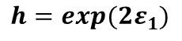
We Can Obtain Analytic Results for Certain Cases
Natural Topography #2
Analytic Values for Configuration Variables y₂, z₁, and z₃
Case where activation enthalpy : x₁ = x₂ = 0.5
$${ ε}_{0}=0$$
B
A
A
y₂
Z₃:
Z₁:
y₂:
B
B
A
A
A
A
A
z₁
y₂
z₁
z₃
Configuration variable
h = 1 (ε₁ = 0)
Orig.
Model
z₃
Nat. Top. #2:
Nat. Top. #1:
y₂ = 0.166
y₂ = 0.180
z₁ = 0.258
z₁ = 0.214
z₃ = 0.109
z₃ = 0.074
h: interaction enthalpy parameter;
$${ h=exp(2ε}_{1})$$

Slide 35
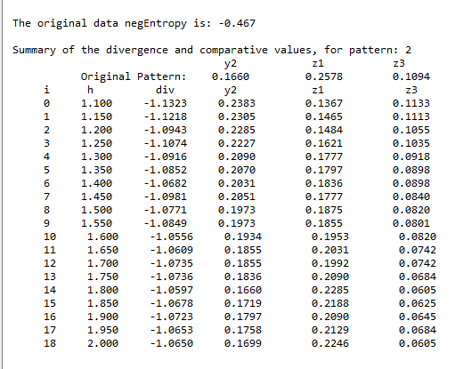
Revised Code: Pattern #2, Intermediate; 2022-04-04; Final Run (for Pattern Image)

Slide 36
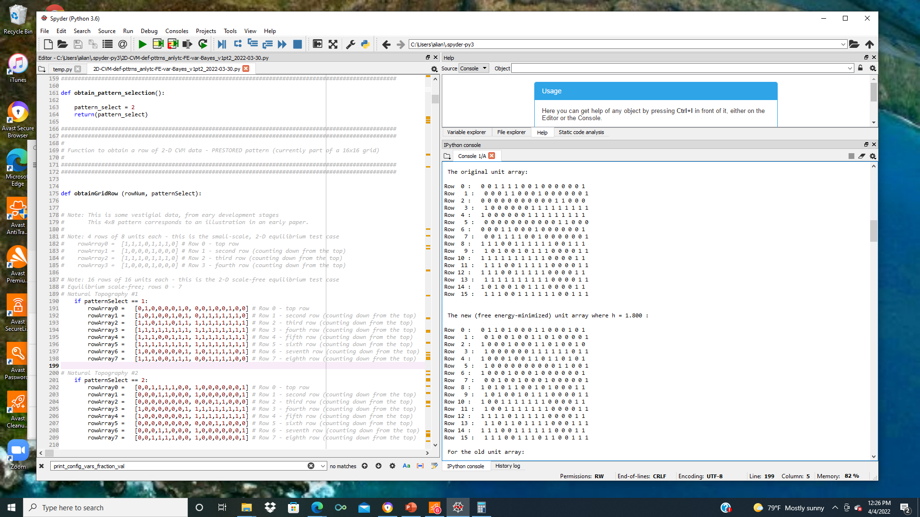
Revised Code: Pattern #2, Intermediate; 2022-04-04; Final Run (for Pattern Image)

Slide 37
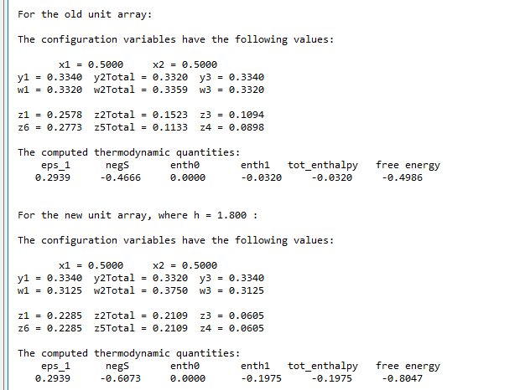
Revised Code: Pattern #2, Intermediate; 2022-04-04; Final Run (for Pattern Image)

Slide 38
Natural Topography #2: Moderate Dispersion – Original Topography
Row 15*
*wrap-around
Row 0
Row 1
Row 2
Row 3
Row 4
Row 5
Row 6
Row 7
Row 8
Row 9
Row 10
Row 11
Row 12
Row 13
Row 14
Row 15

Slide 39
Natural Topography #2: Moderate Dispersion
New Pattern with h = 1.80
Row 15*
*wrap-around
Row 0
Row 1
Row 2
Row 3
Row 4
Row 5
Row 6
Row 7
Row 8
Row 9
Row 10
Row 11
Row 12
Row 13
Row 14
Row 15

Slide 40
We Can Obtain Analytic Results for Certain Cases
Natural Topography #3
Version (a)
Analytic Values for Configuration Variables y₂, z₁, and z₃
Case where activation enthalpy : x₁ = x₂ = 0.5
$${ ε}_{0}=0$$
B
A
A
y₂
Z₃:
Z₁:
y₂:
B
B
A
A
A
A
A
z₁
y₂
z₁
z₃
Configuration variable
h = 1 (ε₁ = 0)
Nat. Top. #3:
z₃
y₂ = 0.422/2
= 0.211
z₁ = 0.182
z₃ = 0.115
h: interaction enthalpy parameter;
$${ h=exp(2ε}_{1})$$

Slide 41
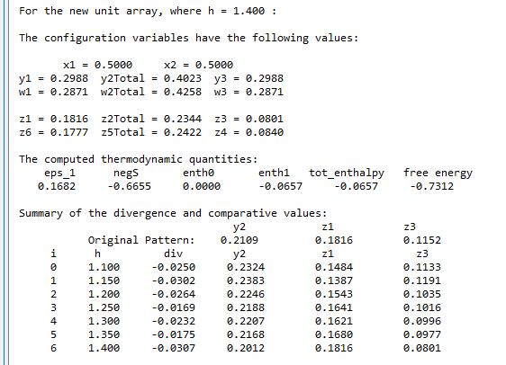
Pattern #3a, Weakly-Connected; 2022-03-30; Run #1

Slide 42

Pattern #3a, Weakly-Connected; 2022-03-30; Run #2

Slide 43

Pattern #3a, Weakly-Connected; 2022-03-30; Run #3

Slide 44
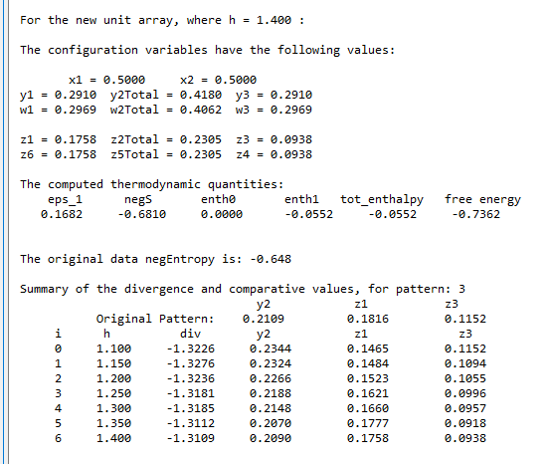
REVISED CODE: Pattern #3a, Weakly-Connected; 2022-03-30; Run #1

Slide 45

REVISED CODE: Pattern #3a, Weakly-Connected; 2022-03-30; Run #2

Slide 46

REVISED CODE: Pattern #3a, Weakly-Connected; 2022-03-30; Run #3

Slide 47
AVERAGE OF RESULTS: Pattern #3a, Weakly-Connected; 2022-03-30
Run Numb. | h | Diverg. | y₂ | z₁ | z₃
1 | 1.35 | -1.3109 | 0.2090 | 0.1768 | 0.0938
2 | 1.35 | -1.3093 | 0.2129 | 0.1777 | 0.0918
3 | 1.35 | -1.3089 | 0.2109 | 0.1738 | 0.0957
AVG. | 1.35 |  | 0.2109 | 0.1768 | 0.0938

Slide 48
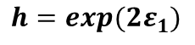
We Can Obtain Analytic Results for Certain Cases
Natural Topography #3
Version (a)
Analytic Values for Configuration Variables y₂, z₁, and z₃
Case where activation enthalpy : x₁ = x₂ = 0.5
$${ ε}_{0}=0$$
B
A
A
y₂
Z₃:
Z₁:
y₂:
B
B
A
A
A
A
A
z₁
y₂
z₁
z₃
Configuration variable
h = 1 (ε₁ = 0)
Orig.
Model
z₃
Nat. Top. #3:
Nat. Top. #1:
y₂ = 0.422/2
= 0.211
y₂ = 0.211
z₁ = 0.182
z₁ = 0.185
z₃ = 0.115
z₃ = 0.087
h: interaction enthalpy parameter;
$${ h=exp(2ε}_{1})$$

Slide 49
We Can Obtain Analytic Results for Certain Cases
Natural Topography #3
Version (b)
Analytic Values for Configuration Variables y₂, z₁, and z₃
Case where activation enthalpy : x₁ = x₂ = 0.5
$${ ε}_{0}=0$$
B
A
A
y₂
Z₃:
Z₁:
y₂:
B
B
A
A
A
A
A
z₁
y₂
z₁
z₃
Configuration variable
h = 1 (ε₁ = 0)
Nat. Top. #3:
z₃
y₂ = 0.445/2
= 0.223
z₁ = 0.162
z₃ = 0.115
h: interaction enthalpy parameter;
$${ h=exp(2ε}_{1})$$

Slide 50
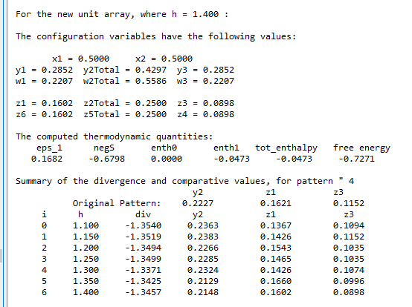
REVISED CODE: Pattern #3b, Weakly-Connected; 2022-03-30; Run #1

Slide 51
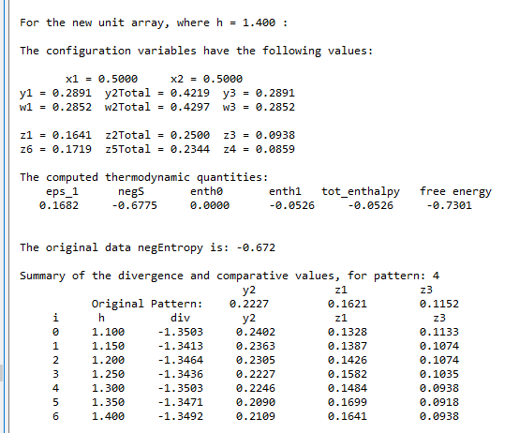
REVISED CODE: Pattern #3b, Weakly-Connected; 2022-03-30; Run #2

Slide 52
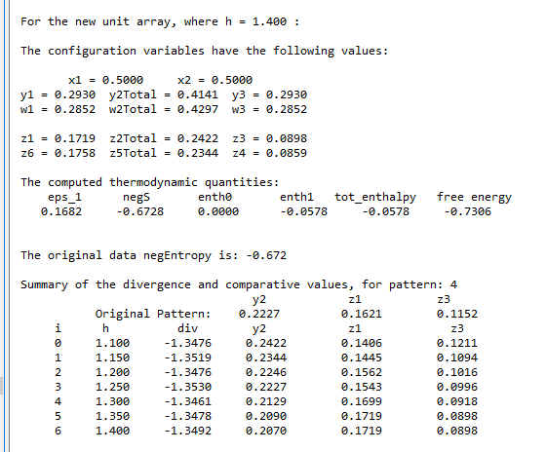
REVISED CODE: Pattern #3b, Weakly-Connected; 2022-03-30; Run #3

Slide 53
AVERAGE OF RESULTS: Pattern #3b, Weakly-Connected; 2022-03-30
Run Numb. | h | Diverg. | y₂ | z₁ | z₃
1 | 1.3 | -1.3371 | 0.2324 | 0.1426 | 0.1074
2 | 1.15 | -1.3413 | 0.2363 | 0.1387 | 0.1074
3 | 1.3 | -1.3463 | 0.2129 | 0.1689 | 0.0918
AVG. | 1.25 |  | 0.2273 | 0.1501 | 0.1022

Slide 54
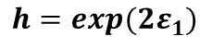
We Can Obtain Analytic Results for Certain Cases
Natural Topography #3
Version (b)
Analytic Values for Configuration Variables y₂, z₁, and z₃
Case where activation enthalpy : x₁ = x₂ = 0.5
$${ ε}_{0}=0$$
B
A
A
y₂
Z₃:
Z₁:
y₂:
B
B
A
A
A
A
A
z₁
y₂
z₁
z₃
Configuration variable
h = 1 (ε₁ = 0)
Orig.
Model
z₃
Nat. Top. #3:
Nat. Top. #1:
y₂ = 0.445/2
= 0.223
y₂ = 0.2273
z₁ = 0.162
z₁ = 0.150
z₃ = 0.115
z₃ = 0.102
h: interaction enthalpy parameter;
$${ h=exp(2ε}_{1})$$

Slide 55
AVERAGE OF RESULTS: Pattern #3a, Weakly-Connected; 2022-03-30
Run Numb. | h | Diverg. | y₂ | z₁ | z₃
1 | 1.35 | -1.3109 | 0.2090 | 0.1768 | 0.0938
2 | 1.35 | -1.3093 | 0.2129 | 0.1777 | 0.0918
3 | 1.35 | -1.3089 | 0.2109 | 0.1738 | 0.0957
AVG. | 1.35 |  | 0.2109 | 0.1768 | 0.0938

Slide 56
Summary of Results Across Four Sets of Trials: #1 - #3b
Sets of Trials for Each Pattern:
Pattern #1 (highly-agglutinated): 6 Trials
Pattern #2 (intermediate): 10 Trials
Pattern #3a (granular, v1): 3 Trials
Pattern #3b (granular, v2): 3 Trials

Slide 57
AVERAGE OF RESULTS: Pattern #1, Rich-Club-Like; 2022-03-30
Run Numb. | h | Diverg. | y₂ | z₁ | z₃
1 | 1.80 | -0.9209 | 0.1660 | 0.2344 | 0.0625
2 | 2.00 | -0.9140 | 0.1523 | 0.2520 | 0.0527
3 | 1.85 | -0.9286 | 0.1621 | 0.2402 | 0.0566
4 | 1.95 | -0.9124 | 0.1602 | 0.2441 | 0.0605
5 | 1.90 | -0.9329 | 0.1660 | 0.2285 | 0,0645
6 | 1.95 | -0.9138 | 0.1621 | 0. 2326 | 0,0645
AVG. | 1.91 |  | 0.1614 | 0.2386 | 0.0602

Slide 58
AVERAGE OF RESULTS: Pattern #2, Intermediate; 2022-04-04
Run Numb. | h | Diverg. | y₂ | z₁ | z₃
1 | 1.50 | -1.0487 | 0.1895 | 0.2012 | 0.0801
2 | 1.70 | -1.0443 | 0.1777 | 0.2168 | 0.0723
3 | 1.75 | -1.0311 | 0.1738 | 0.2207 | 0.0723
4 | 1.75 | -1.0480 | 0.1797 | 0.2109 | 0.0742
5 | 1.75 | -1.0463 | 0.1895 | 0.2012 | 0.0801
6 | 1.80 | -1.0468 | 0.1719 | 0.2207 | 0.0684
7 | 1.55 | -1.0613 | 0.2012 | 0.1875 | 0.0898
8 | 1.90 | -1.0375 | 0.1758 | 0.2148 | 0.0742
9 | 1.85 | -1.0399 | 0.1758 | 0.2227 | 0.0703
10 | 2.00 | -1.0348 | 0.1621 | 0.2383 | 0.0625
AVG. | 1.755 | -1.0434 | 0.1800 | 0.2135 | 0.0744

Slide 59
AVERAGE OF RESULTS: Pattern #3a, Weakly-Connected; 2022-03-30
Run Numb. | h | Diverg. | y₂ | z₁ | z₃
1 | 1.35 | -1.3109 | 0.2090 | 0.1768 | 0.0938
2 | 1.35 | -1.3093 | 0.2129 | 0.1777 | 0.0918
3 | 1.35 | -1.3089 | 0.2109 | 0.1738 | 0.0957
AVG. | 1.35 |  | 0.2109 | 0.1768 | 0.0938

Slide 60
AVERAGE OF RESULTS: Pattern #3b, Weakly-Connected; 2022-03-30
Run Numb. | h | Diverg. | y₂ | z₁ | z₃
1 | 1.3 | -1.3371 | 0.2324 | 0.1426 | 0.1074
2 | 1.15 | -1.3413 | 0.2363 | 0.1387 | 0.1074
3 | 1.3 | -1.3463 | 0.2129 | 0.1689 | 0.0918
AVG. | 1.25 |  | 0.2273 | 0.1501 | 0.1022

Slide 61
Summary of Lowest-Divergence Results: Patterns #1 - #3b; 2022-04-14
Run Numb. | h | Diverg. | y₂ | z₁ | z₃
1 | 1.95 | -0.9124 | 0.1602 | 0.2441 | 0.0605
2 | 1.75 | -1.0311 | 0.1738 | 0.2207 | 0.0723
3a | 1.35 | -1.3089 | 0.2109 | 0.1738 | 0.0957
3b | 1.30 | -1.3371 | 0.2324 | 0.1426 | 0.1074

Slide 62
Code Documentation
GitHub Private Repository:
https://github.com/ajmaren/2-D-CVM-w-Var-Bayes
Code:
2D-CVM-def-pttrns_anlytc-FE-vary-e1-v1pt5_2021-04-08.py
Functionality:
This code still has the old “random pattern” capabilities in it, but is used for defined pattern experiments
All four patterns used in the experimental trials here are encoded directly into the program
The program must be run separately for each trial, with a range of h-values that can be specified in __main__

